Slide 1




Pokemon Battle Analysis
20/09/2024
DATA1030 Final Presentation
Taemin Huh
Brown University DSI
https://github.com/taemin-huh/data1030-project/

Slide 2
Introduction
Target variable: Win Rate (regression problem)
12 features: pkmn dataset (800 Pokemon info datapoints - Kaggle)
ID: Pokedex Number, Pokemon Name
Type: Type 1, Type 2
6 stats: HP, Attack, Defense, Sp. Atk, Sp. Def, Speed
Class: Generation, Legendary
3 features: battle dataset (50,000 Pokemon battle datapoints - Kaggle)
First Pokemon, Second Pokemon, Winner
Notes:
The Pokémon franchise is one of the highest grossing media franchises, with the game alone selling 440 million copies worldwide. Competitive Pokémon battling became an established discipline with large-scale tournaments, cash prizes and scholarships, and the next Pokémon to include in the team has often been a popular discussion. This project attempts to solve the regression problem of predicting the win rate of a given Pokemon in battle, and uses two datasets published by the Weedle’s Cave project on Kaggle. The Pokémon dataset contains 12 features of 800 Pokémons collected from the actual game, while Combat dataset contains datapoints of 50,000 battles generated through a custom algorithm.

Slide 3
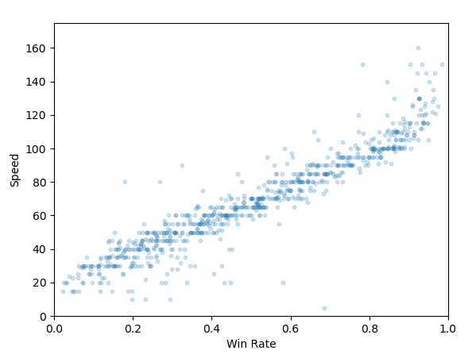
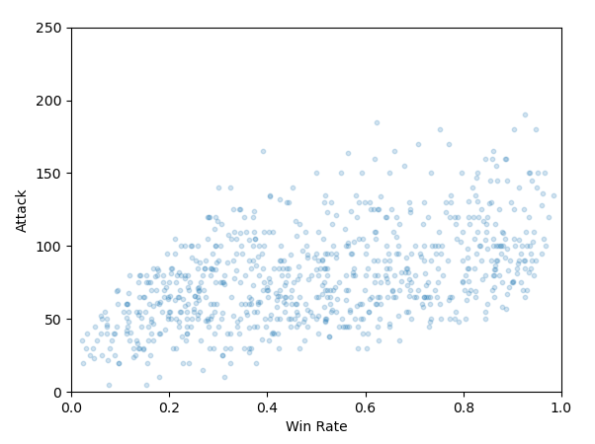
Exploratory Data Analysis
Scatter Plot: Speed vs. Win Rate
Scatter Plot: Attack vs. Win Rate
Strong correlation (~0.94)
Some correlation (~0.50)
Notes:
From EDA, it was notable that Speed is the feature with the strongest correlation to win rate with a 0.94 Pearson correlation coefficient. This makes sense, as higher speed lets you move first, and being able to consistently hit first each turn often translates to an extra turn before the opponent faints, or a single-hit KO on the first turn. We can also see that Attack also has some correlation at 0.5.

Slide 4
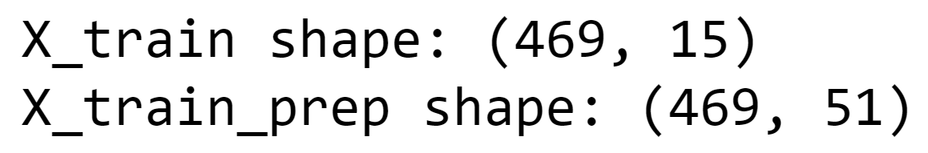
Pre-Processing
Basic split (IID, large # of datapoints)
60%/20%/20% for train/test/split
Pre-processors
OneHotEncoder: Type1 (18), Type2 (19), Generation (6), Legendary(2)
MinMaxScaler: HP, Attack, Defense, Sp. Atk, Sp. Def, Speed (0-255 each)
51 features after pre-processing (15-5+17+18+5+1)
Notes:
A basic split of 60%/20%/20% was used across train/test/validation sets, as the data is IID without any group structure or time-series property. OneHotEncoder was used for the four categorical features, while MinMaxScaler was used for the six base stats as they have a hard range limit of 0 to 255, resulting in 51 features total after pre-processing.

Slide 5
Cross-Validation
Attempted supervised ML algorithms
Multiple linear regression, SVM, decision tree, random forest, XGBoost
GridSearchCV w/ 5-fold CV to tune hyperparameters
Tuned hyperparameters
Linear regression: fit_intercept
SVM: kernel, C, gamma
XGBoost: n_estimators, learning_rate, max_depth, subsample, colsample_bytree
Decision tree: max_depth, min_samples_split
Random forest: n_estimators, max_depth
Repeated 5-fold CV w/ 10 repeats for uncertainty estimation
Notes:
The ML pipeline includes two linear and three tree-based models. For each model, key parameters were tuned using GridSearchCV with 5-folds, calculating the optimal combination based on our evaluation metric.
For linear regression, we considered whether to include the intercept; for SVM, we did kernel type, regularization parameter, and gamma to balance margin maximization and individual sample influence; for decision tree, max depth to decide how deep the tree would grow, and minimum sample split to ensure splitting occurs only with sufficient samples; for random forest, we did number of trees and max depth to balance complexity and predictive power; for XGBoost, number of boosting rounds, learning rate, max depth, subsample size and fraction of features per tree to optimize performance and efficiency.
Repeated 5-fold CV with 10 repeats were used on all models to calculate uncertainties introduced by splitting method. The data was split into 5 folds, with each fold serving as the validation or test set while others as train sets. This was repeated 10 times with random splits, and the standard deviation of MAE across all runs were calculated to assess how performance varies due to random sampling. For models with inherent randomness by design such as random forest and XGBoost, the 10 repeats were run with varying random seeds instead of random splits, to again calculate overall standard deviation of MAE to derive non-deterministic uncertainty.

Slide 6
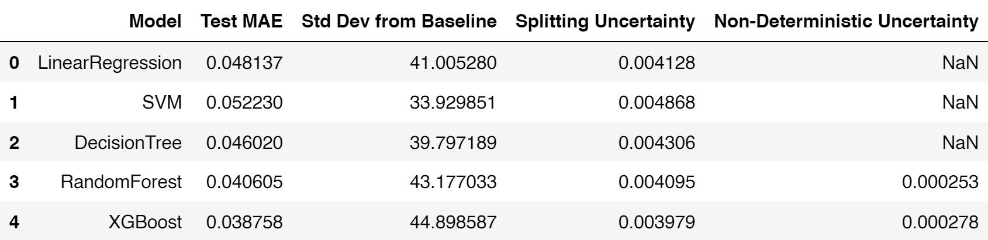

Results
Table: Performance & Uncertainty Evaluation
Primary Evaluation Metric
Best Performing Model
Baseline MAE
Notes:
MAE was chosen as the evaluation metric due to its interpretability and relevance. It's in the same units as the target variable, making it intuitive to understand to the end-user. It also treats all errors equally by taking the absolute difference between predicted and actual values, making it less sensitive to outliers for a more balanced view. On the other hand, for example, MSE would square the error terms and heavily penalize outliers, magnifying these effects and potentially skewing our evaluation.
As you can see, XGBoost showed the highest performance with the lowest MAE of 0.039. This is 45 standard deviations above the baseline model’s MAE of 0.2, representing a significant improvement. The baseline was calculated through a naïve model using the mean of the y_train of basically 0.5 for all predictions. The splitting uncertainty for XGBoost is also the smallest among all models, with also a negligible non-deterministic uncertainty, meaning it shows low variability across different splits and performs consistently even with inherent randomness.

Slide 7
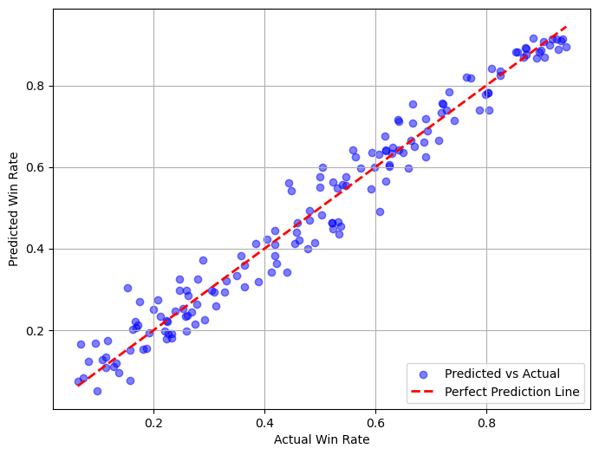
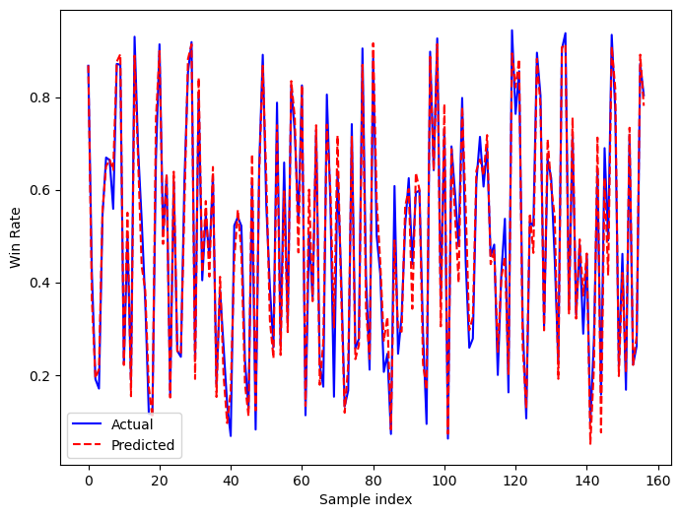
Results (Cont’d)
Scatter Plot: Actual vs. XGBoost Predicted Win Rate
Line Plot: Actual vs. XGBoost Predicted Win Rate
Both plots show meaningfully close predictions vs. actual
Notes:
As you can see from the left hand side, the dots representing predicted vs. actual are clustered closely around the perfect prediction line. On the right hand side, the dotted predicted lines also closely overlap with the actual blue line, indicating meaningful predictive performance.

Slide 8
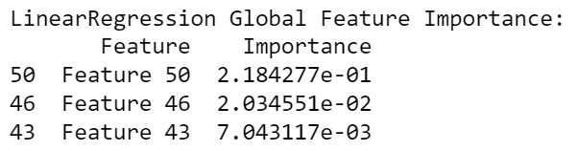
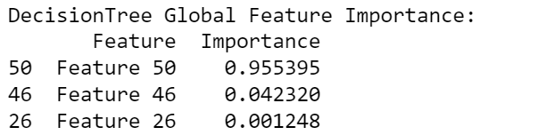
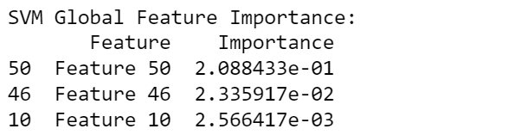
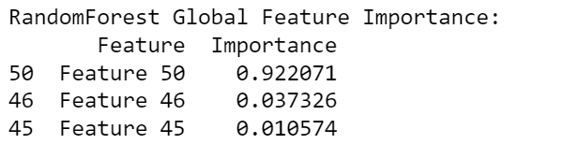
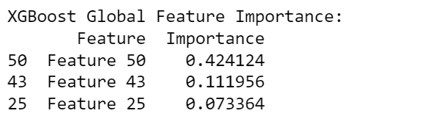
Results (Cont’d)
Global Feature Importances
Permutation Importance (Linear Models)
Gini Importance (Tree-Based Models)
Feature 50 (Speed) has the highest importance score across all regressions
Notes:
Global feature importances were calculated by model type. For linear models, permutation importance was used to measure decrease in performance after feature values were randomly shuffled, and for tree-based models, their built-in Gini importance was used to measure mean decrease in impurity. These tables show the top 3 in terms of global feature importance for each model. Feature 50 (Speed) ranks as the most important feature across all models by a wide margin, which is consistent with our findings during EDA. Feature 46 (Attack) is also notably important by ranking second in 4 out of 5 models.

Slide 9
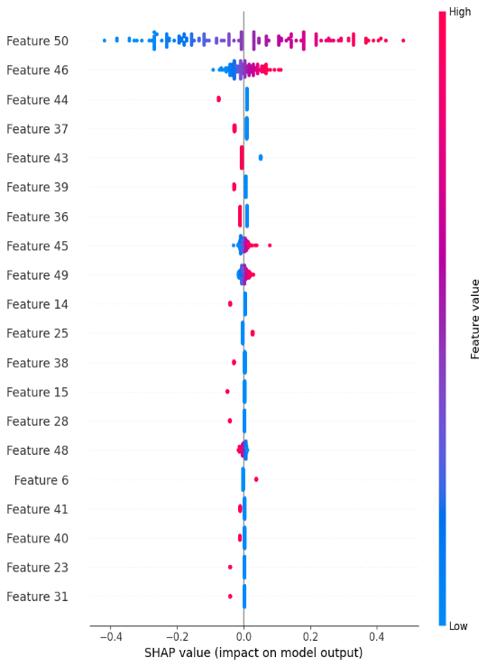
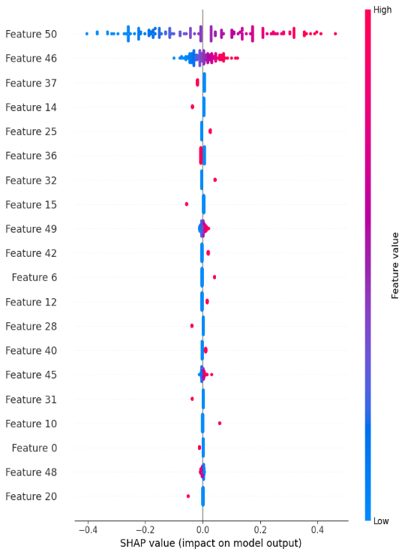
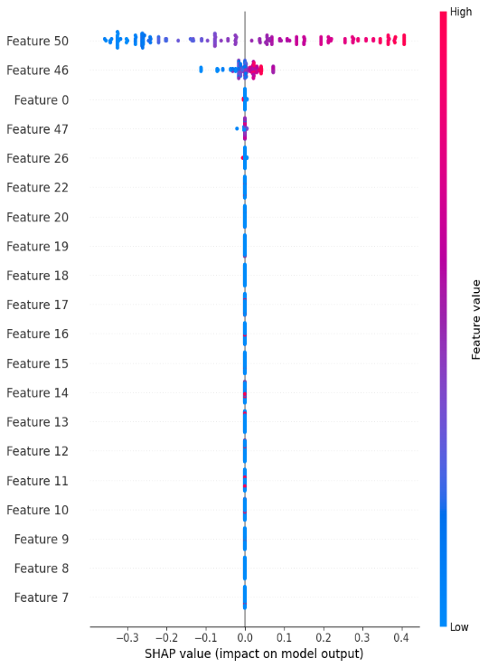
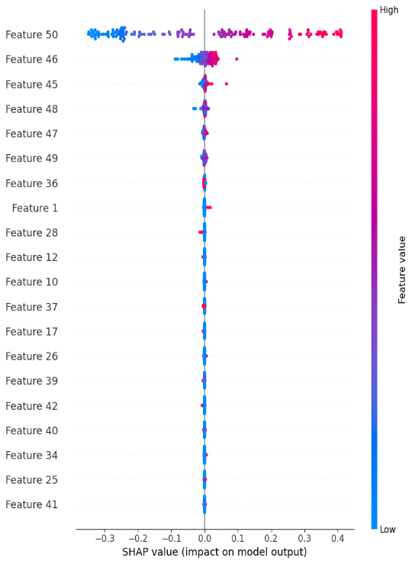
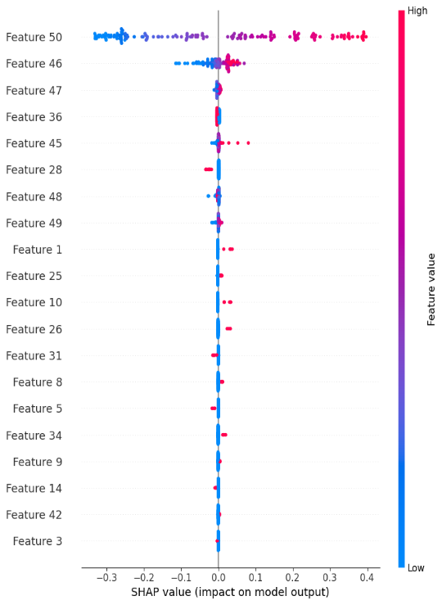
Results (Cont’d)
Global Feature Importances: SHAP Summary Plots
Linear Regression
SVM
Decision Tree
Random Forest
XGBoost
Feature 50 (Speed) has the highest absolute SHAP values across all regressions
Notes:
These are global SHAP summary plots, which show similar findings.

Slide 10
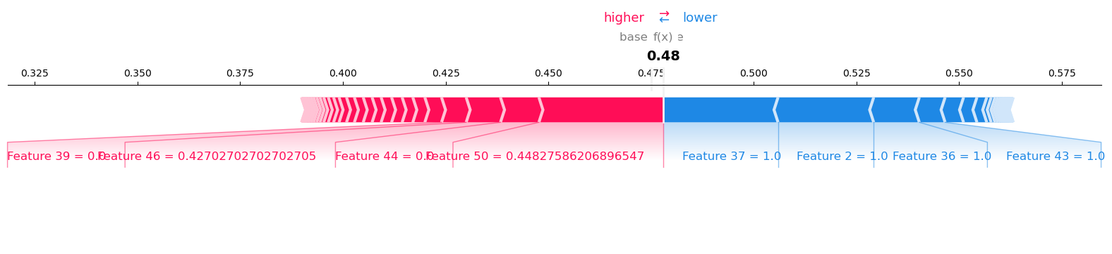
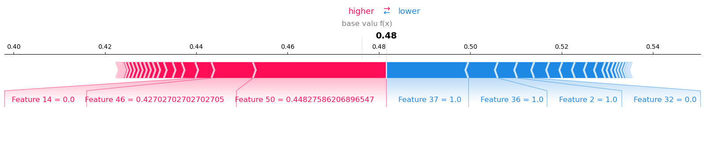
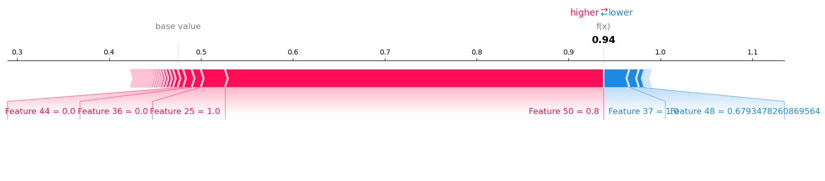
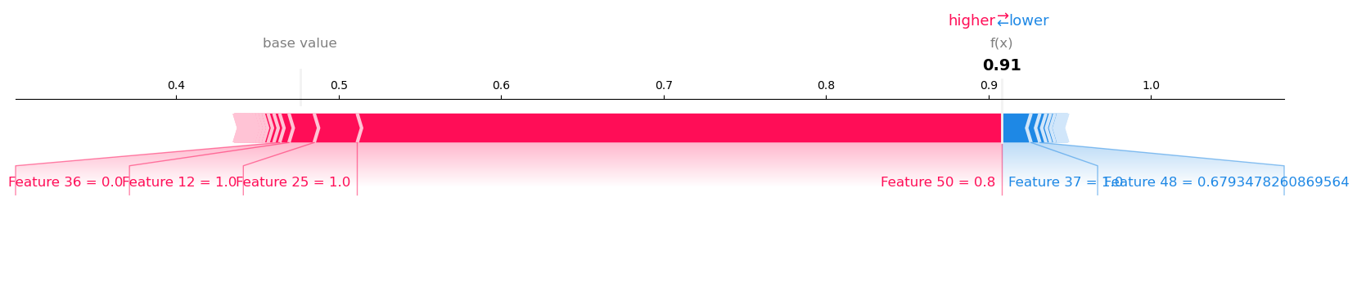
Results (Cont’d)
Local Feature Importances: SHAP Force Plots
Linear Regression: Typical Case (Above) & Edge Case (Below)
SVM: Typical Case (Above) & Edge Case (Below)
Notes:
Local feature importances were calculated through SHAP values of two instances: a typical case and an edge-case for better representation. Former was selected by identifying the one with the closest prediction to the median prediction, and the latter by the one with the largest prediction (argmax). As you can see, Speed still consistently ranks as the most locally important feature.

Slide 11
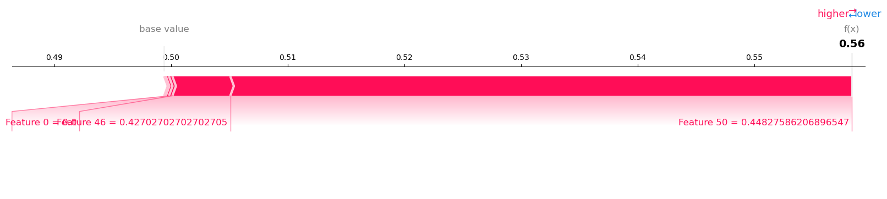
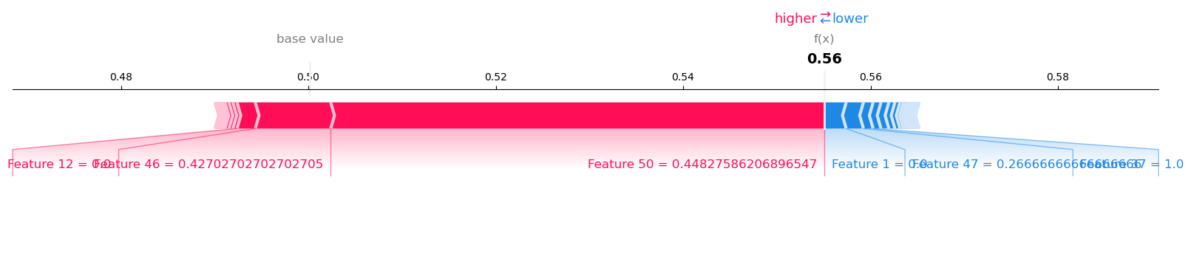
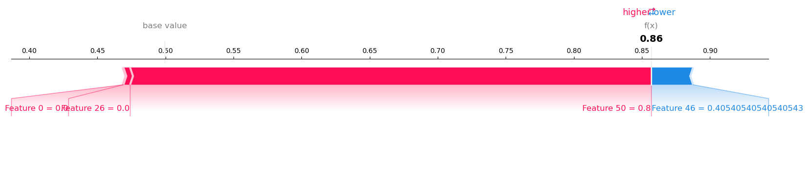
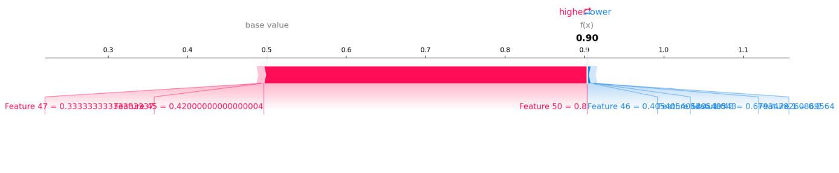
Results (Cont’d)
Local Feature Importances: SHAP Force Plots
Decision Tree: Typical Case (Above) & Edge Case (Below)
Random Forest: Typical Case (Above) & Edge Case (Below)

Slide 12
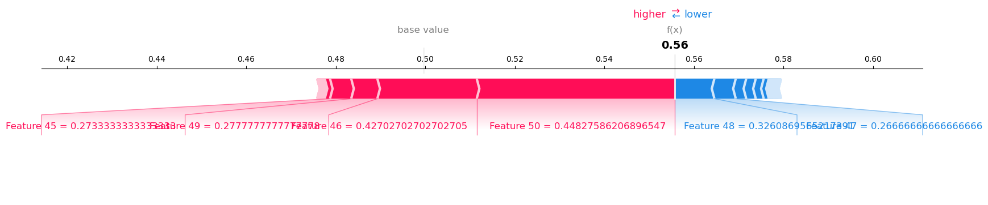
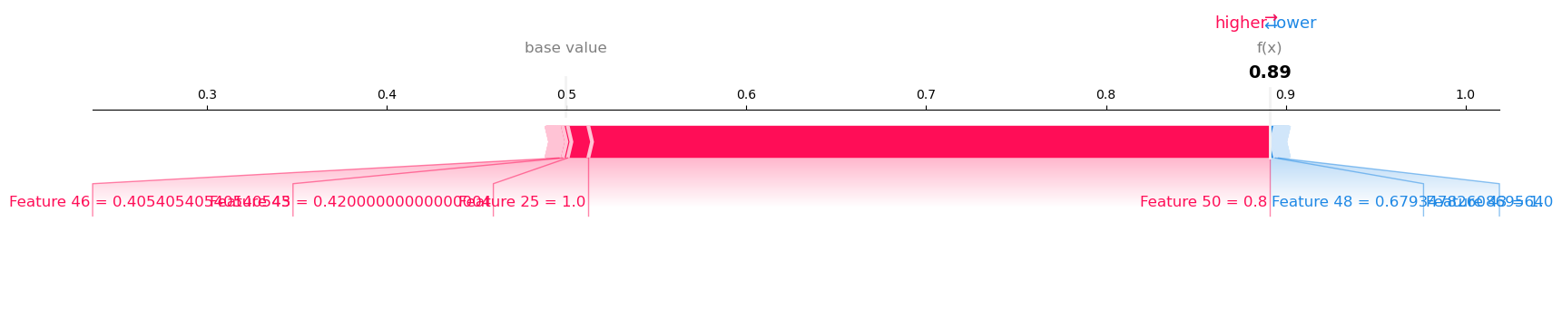
Results (Cont’d)
Local Feature Importances: SHAP Force Plots
XGBoost: Typical Case (Above) & Edge Case (Below)
Notes:
So, it can be concluded that the Speed stat is arguably the most important feature that affects Pokémon battle win rates both locally and globally.

Slide 13
Outlook
Additional data
25 Pokemon natures
Level
Held items & abilities
Movesets
Competitive play pick rate
Combining multiple models through stacking
Creating partial dependence plots (PDP’s)
Implementing neural networks given enough data
Notes:
The project could be improved by sourcing additional game data, such as Pokémon natures, level, held items that also affect the outcome of battle. Also, data on each Pokémon’s competitive play pick rate would greatly enhance our analysis – as pick rate is one of the most important measures for competitive viability in many gaming stats platforms, as popular picks usually indicate meta-relevant strategies that perform well in the current environment. Lastly, given more time, the analysis could benefit from combining strengths of multiple models through stacking to improve prediction accuracy, creating PDP’s to show how a predicted outcome can change as a single feature changes with others held constant, and even implementing neural network models when given enough data.

Slide 14

Thank You
Notes:
This is the end of my presentation, thanks for listening.

